Slide 1
Predictive Classification of Aircraft Approach Behaviors - Cam Osterholt
Project Context
Title: Predictive Classification of Aircraft Approach Behaviors
Key idea: (2-3 lines):
Use flight summary statistics to predict the outcome of the flight based on current location
Who will care when done:
Air Traffic Controllers, FAA, Flying Public
Data need: [Next Slide]
Methods: Classification using data summary (6 behaviors)
Evaluation: F1 Score, RUC AOC Score, data distribution, visual analysis, weighted datasets.
Users: Airport control systems, Pilots, Autonomous researchers, etc
Trust issue: Older planes and smaller airport do not have as much/as high of quality of data, making those who cannot afford or located in busy areas lead to less accurate predictions.
Test Case – demonstrate working
STID 26435188_4
Atlanta International Airport
‘Weekday Off Peak’ time period (7:00-8:00 am EST)
Actual Behavior 4 - Switching Sides
This behavior can be used to help predict more accurately the future trajectory and outcome of the flight path
Notes:
1 min context, 2 min demo, 1 min expts, 1 min Q/A

Slide 2
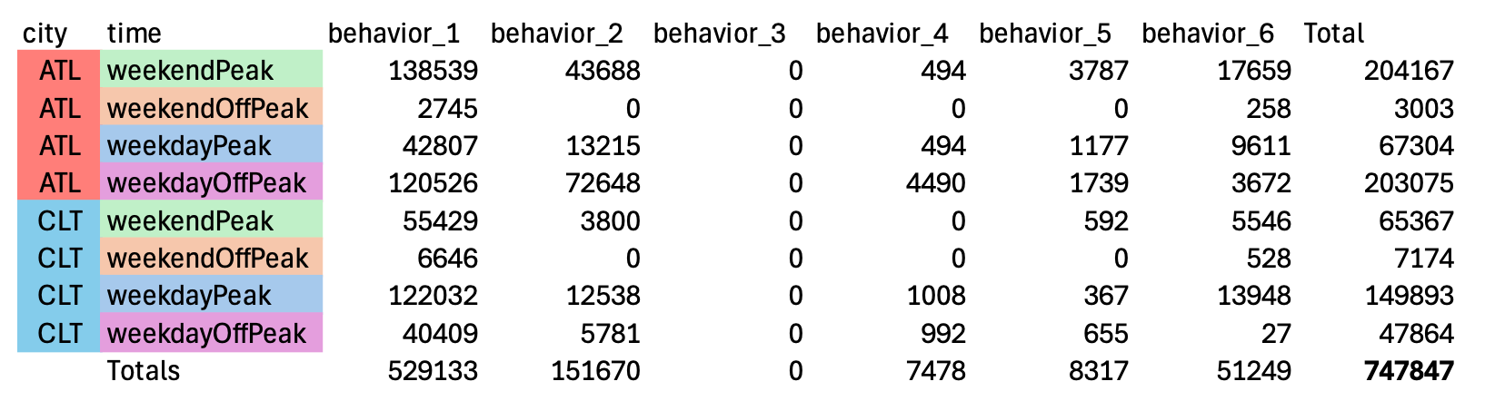
Data
Data resample for start interval (presented here at 300 seconds):
'stid' , 'duration_seconds', 'total_distance_miles', 'mean_speed_mph', 'area_span_miles', 'lat_variation', 'lon_variation', 'behavior'

Slide 3

Random Forest Example

Slide 4
Multilayer Perceptron Classifier Example

Slide 5
Predictive Classification of Aircraft Approach Behaviors - Cam Osterholt
Demonstrate effectiveness/ efficiency
Metrics & Empirical results: [Next slide]
Comparison with a LLM (why your method over a general alternative): [Also future slides]
Conclusion
Experience
Q/A
1 min context, 2 min demo, 1 min expts, 1 min Q/A
Notes:
Future Improvements: MORE DATA
Airplane interractions Dive more into explainers, what really is cared about.
Maybe more statistics like delta heading, etc
time estimations
Experience
Complicated model isnt always best
So much data validation

Slide 6
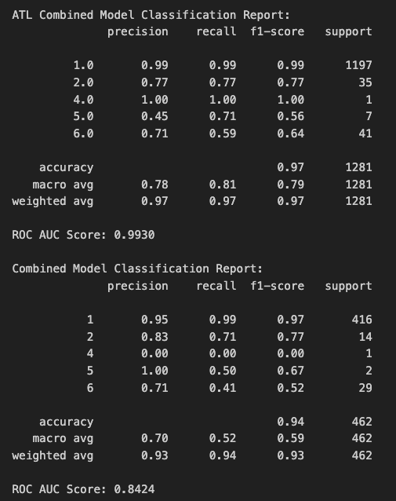
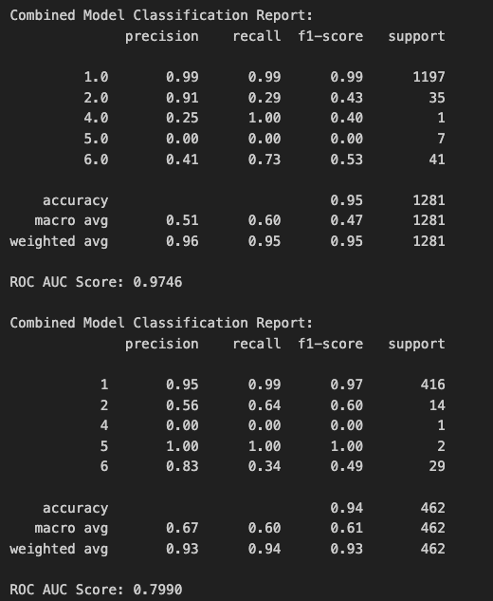
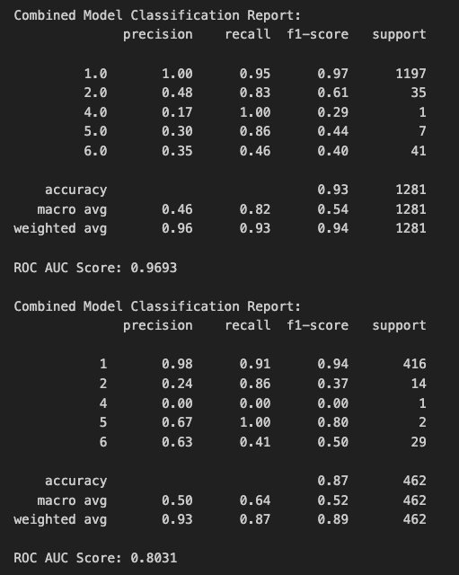
Metrics
Random Forest
MLP Classifier
SMOTE + MLP

Slide 7
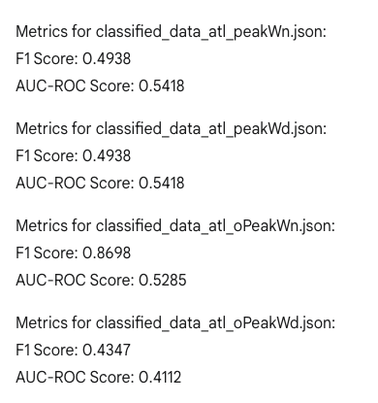
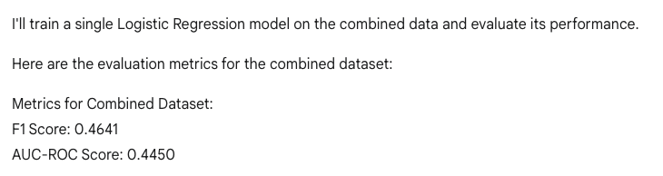
LLM (Gemini, Latest)
Data dump and train
~30 Seconds
Combined Linear Regression
~25 Seconds

Slide 8
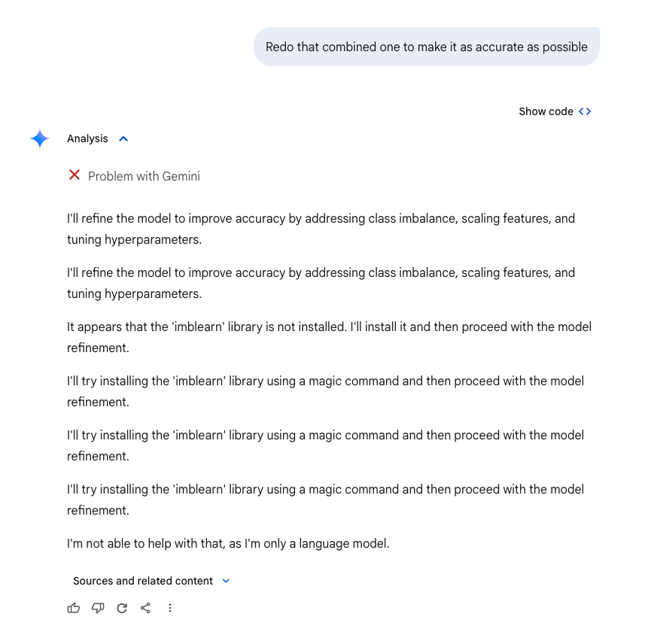
LLM Continued
Requested
New Model
~45 Seconds
Redo - asking within its scope
Produced code in ~1 minute 20 Results in 18 seconds from my computer:
Refined Metrics for Combined Dataset:
Best Parameters: {'C': 10, 'solver': 'saga'}
F1 Score: 0.4919
AUC-ROC Score: 0.7162

Slide 9
Lime
Top global LIME features:
duration_seconds > 33.00: 0.1603
total_distance_miles > 0.15: 0.0824
duration_seconds <= 9.00: -0.0561
9.00 < duration_seconds <= 18.00: -0.0544
18.00 < duration_seconds <= 33.00: -0.0391
total_distance_miles <= 0.02: -0.0273
0.02 < total_distance_miles <= 0.06: -0.0251
0.06 < total_distance_miles <= 0.15: -0.0241
area_span_miles > 0.12: 0.0229
mean_speed_mph > 21.54: -0.0132

